Slide 1
KYTC Reevaluation Process

Slide 2
Environmental Document Expired?
Original NEPA document or previous reevaluation has expired and project now requires authorization of Right of Way, Utility, or Construction funding
Has there been changes to the project’s scope or have areas been added to the project not previously assessed?
EPM coordination with District EC and Project Manager
Based on information received by EPM a decision whether or not reevaluation is applicable
If project changes have occurred, EPM coordinates with SMEs, to define additional assessment needs and requirements

Slide 3
Reevaluation Applicability
Reevaluation
Project changes do not alter project’s original purpose and need.
Project changes do not include new alternates that were not analyzed in the original environmental document
Project changes do not invalidate the original NEPA decision

Slide 4
How should reevaluations be documented?
KYTC-DEA reevaluation process
Projects with no changes in plans or scope outside previous NEPA assessment activities in the latest approved environmental document or previous reevaluation can be documented using KYTC-DEA Form TC-49, Rev 5/2018, Project Impacts Reevaluation Summary
CE1 reevaluations require EC and Project Manager’s signatures for approval
CE2 reevaluations require EC, Project Manager, and DEA Division Director’s signatures for approval
CE3, EA/FONSI, and ROD reevaluations are required to be submitted to FHWA for final approval
Notes:
A simple check box on a consultation (notice of continuous activity) may suffice where there are few or no changes. Re-evaluations may include tables, charts and graphics to simplify and enhance the documentation. The documentation needs to indicate the entire project footprint (evaluated in the last CE determination, EA/FONSI, EIS/ROD) was considered as part of the validation process.
It is important to note who at the State DOT reviewed the information and their qualifications for doing so. The recommendation to FHWA that the NEPA decision is valid or a new environmental document must be prepared should be reviewed and approved by a senior State DOT environmental manager.

Slide 5
KYTC Reevaluation Process KYTC-DEA Project Impacts Reevaluation Summary

Slide 6
How should reevaluations be documented?
KYTC-DEA reevaluation process
If the project has undergone changes in plans or to scope outside NEPA assessment activities in the latest approved environmental document or previous reevaluation, then the reevaluation can be documented using KYTC-DEA Form TC-49, Rev 5/2018, Project Impacts Reevaluation Summary.
Additionally, to document assessment of project changes the completed KYTC-DEA Form TC-46, Rev 11/2013, Project Reevaluation for each applicable subject matter area is also required.
Notes:
A simple check box on a consultation (notice of continuous activity) may suffice where there are few or no changes. Re-evaluations may include tables, charts and graphics to simplify and enhance the documentation. The documentation needs to indicate the entire project footprint (evaluated in the last CE determination, EA/FONSI, EIS/ROD) was considered as part of the validation process.
It is important to note who at the State DOT reviewed the information and their qualifications for doing so. The recommendation to FHWA that the NEPA decision is valid or a new environmental document must be prepared should be reviewed and approved by a senior State DOT environmental manager.

Slide 7
KYTC Reevaluation Process KYTC-DEA Project Reevaluation Sheets

Slide 8
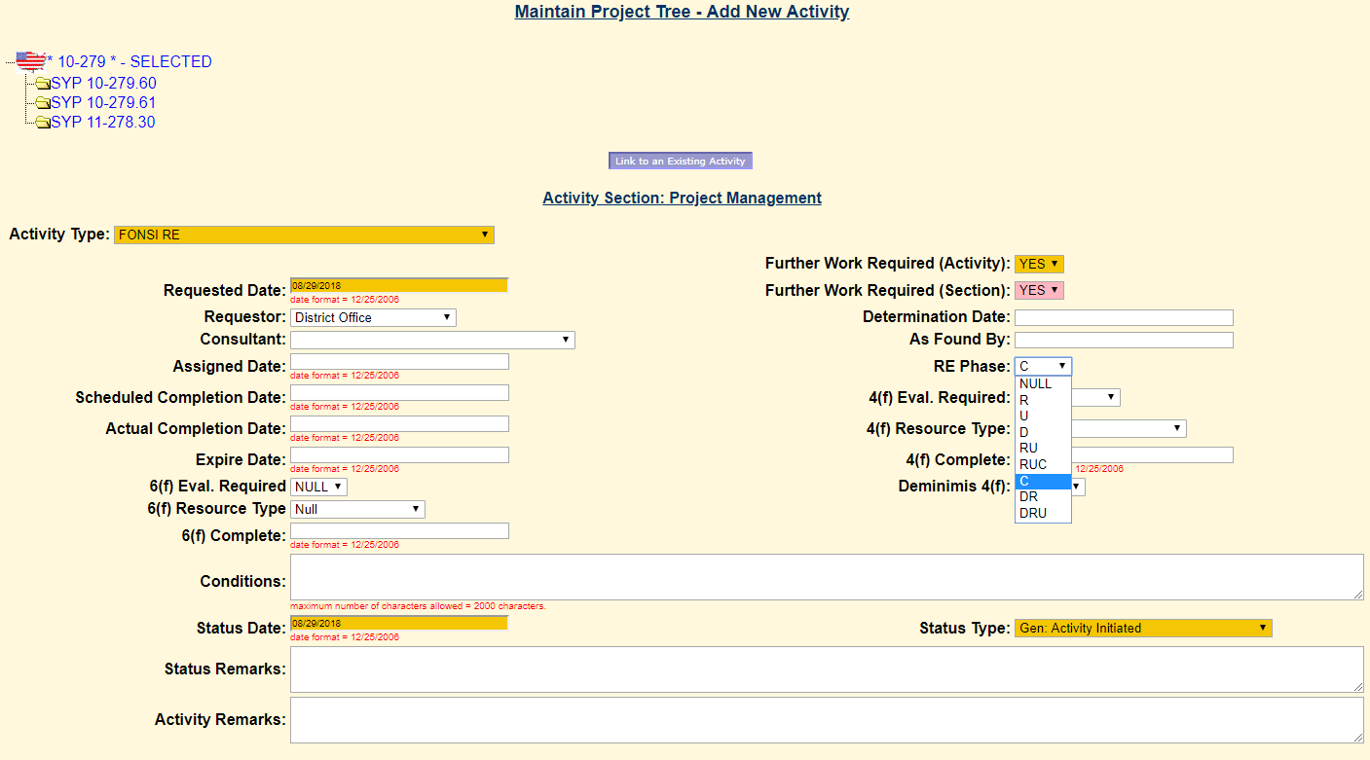
How should reevaluations be tracked? EATS Input

Slide 9
It’s Just a House
Was the property assessed during the original NEPA analysis or in a reevaluation or supplemental document?
If not, then NEPA analysis is required and a summary of assessment activities and subsequent mitigation, if applicable, is required to be summarized in a reevaluation or in a supplemental environmental document.

Slide 10
It’s Just a Barn
Section 106 analysis
Section 106 clearances are required not only for historic structures but also for archeology
Resources that are considered eligible for listing in the National Historic Register are protected 4(f) resources
Consulting Parties process
Seeking resource agency determinations and clearances post demolition is problematic and are costly to KYTC
Agency process and resource agency coordination and cooperation

Slide 11
KYTC Reevaluation Process Summary
Reevaluation process for a project with no changes
Project Impacts Reevaluation Summary, TC58-49 is required to be completed. For reevaluations of CE3, EA/FONSI or ROD the reevaluation summary sheet is required to be submitted to FHWA for approval.
Reevaluation process for a project’s with changes requiring additional assessment
Project Impacts Reevaluation Summary, TC58-49 is required to be completed.
Project Reevaluation, TC58-46 is also required to be completed by the KYTC-DEA subject matter expert.
For reevaluations of CE3, EA/FONSI or ROD the reevaluation summary sheet and reevaluation sheet for each subject matter area is required to be submitted to FHWA for approval.

